Slide 1
MULTIVARIATE GAUSSIAN DISTRIBUTION
CS 557 Statistical Pattern Recognition and Learning
Mehreen Saeed
.

Slide 2
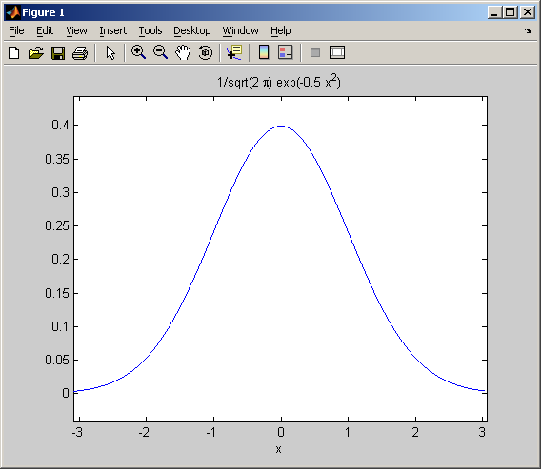
ONE D GAUSSIAN
The y axis is the value of density at x. You can plot this in Matlab using the ezplot
Experiment with different values of variance

Slide 3
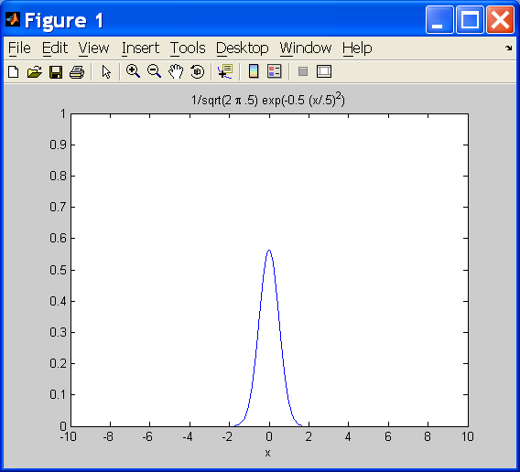
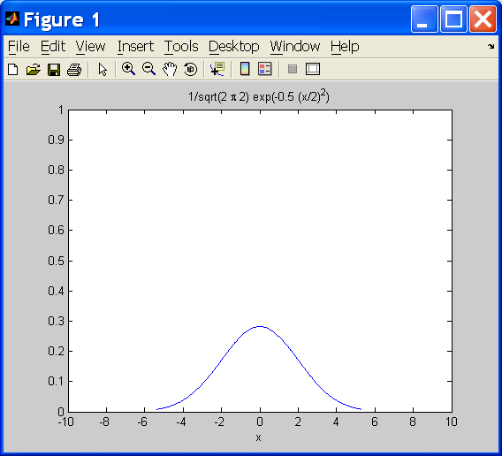
ONE D GAUSSIAN
Matlab code:
ezplot('1/sqrt(2*pi*.5)*exp(-0.5*(x/.5)^2)')
axis([-10,10,0,1])
Matlab code:
ezplot('1/sqrt(2*pi*2)*exp(-0.5*(x/2)^2)')
axis([-10,10,0,1])
Mean = 0, variance = 0.5
Mean = 0, variance = 2
Notice how variance changes the shape of the curve. Changing the mean will only shift the curve

Slide 4
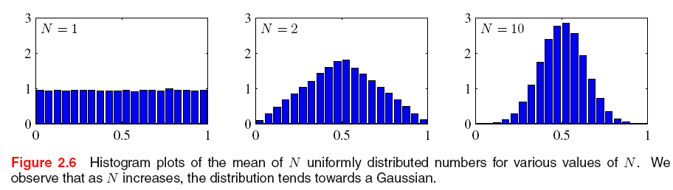
ILLUSTRATION OF CENTRAL LIMIT THEOREM
CENTRAL LIMIT THEOREM
the mean of a sufficiently large number of independent random variables, each with finite mean and variance, will be approximately normally distributed (wikipedia)
REF: Bishop Chapter 2

Slide 5
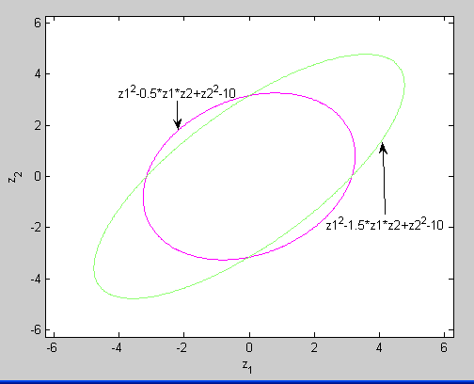
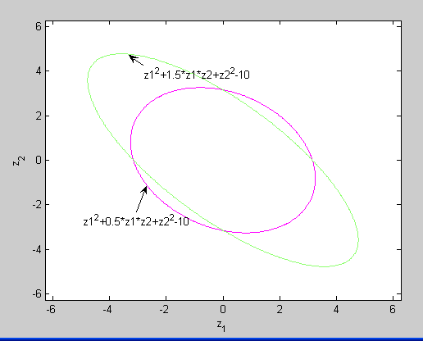
SOME PLOTS FOR QUADRATIC EXPRESSION
Positive correlation
Done in Matlab using ezplot
Negative correlation

Slide 6
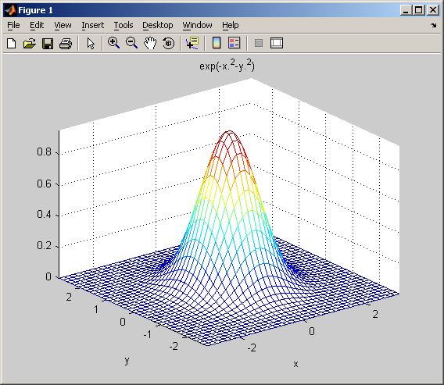
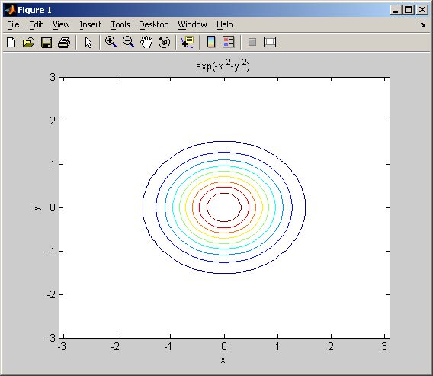
SHAPE FOR 2D
The shape of actual pdf
Volume integrates to one
Z axis gives the value of density at a point (x,y)
The contours on xy plane
In this case x and y are indpendent
You can also generate these plots in matlab using ezmesh and ezcountour

Slide 7
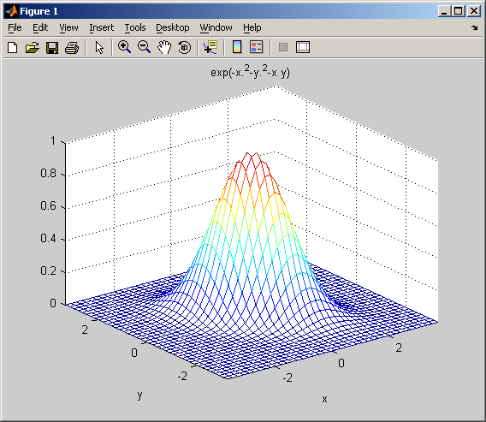
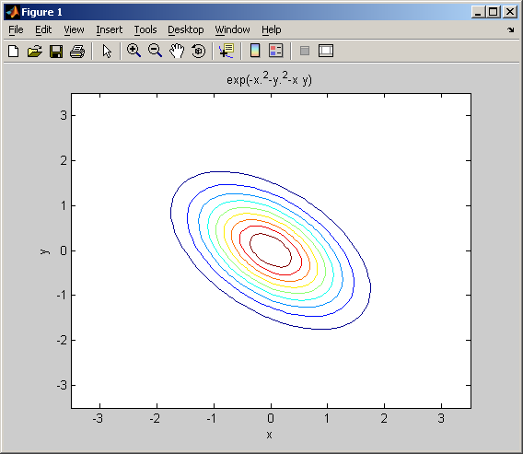
ANOTHER EXAMPLE…
The shape of actual pdf
Z axis gives the value of density at a point (x,y)
The contours on xy plane
You can generate these plots in matlab using ezmesh and ezcountour

Slide 8
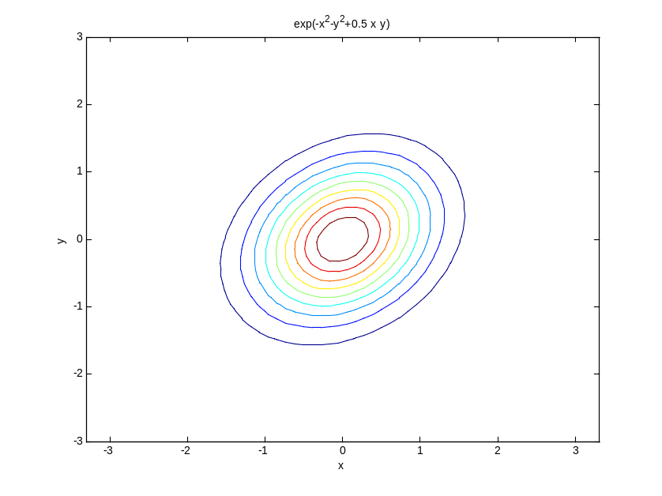
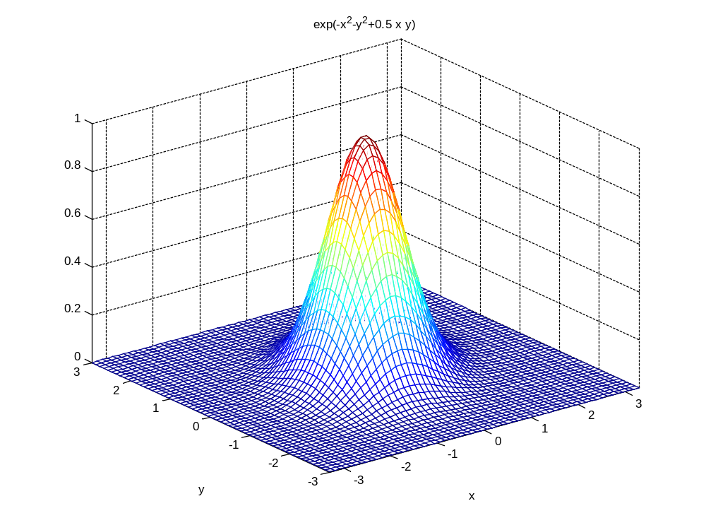

Slide 9
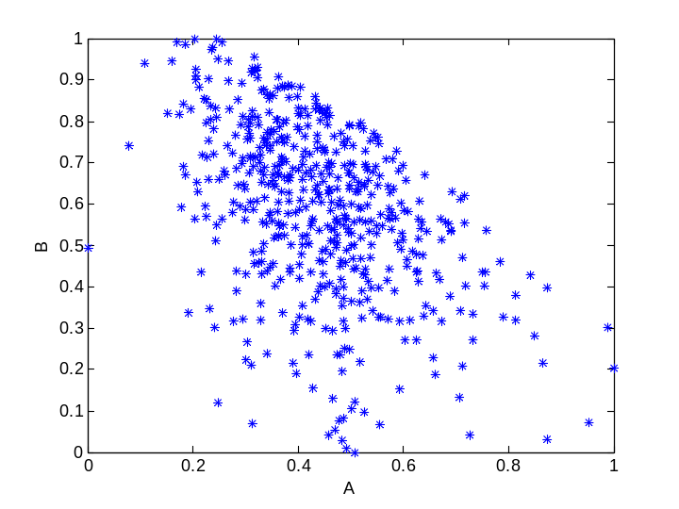
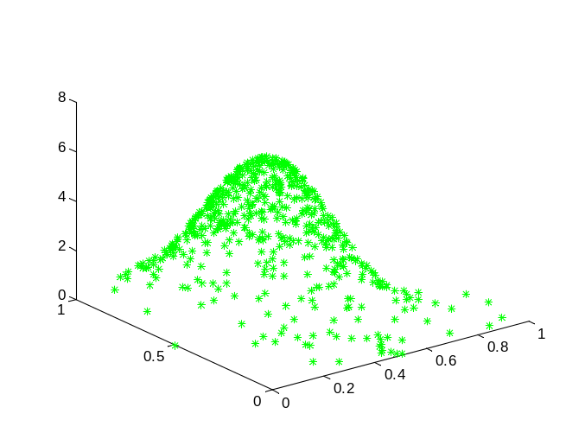
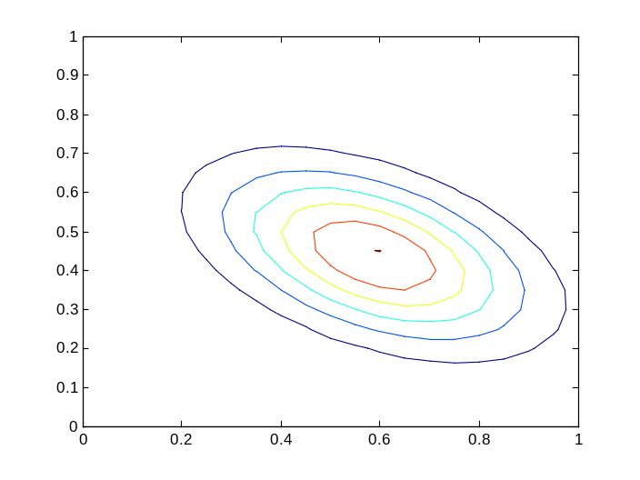
DATA & DISTRIBUTION
0.0210 -0.0137
-0.0137 0.0417
correlation = -0.4630
Comment: (A->B)

Slide 10
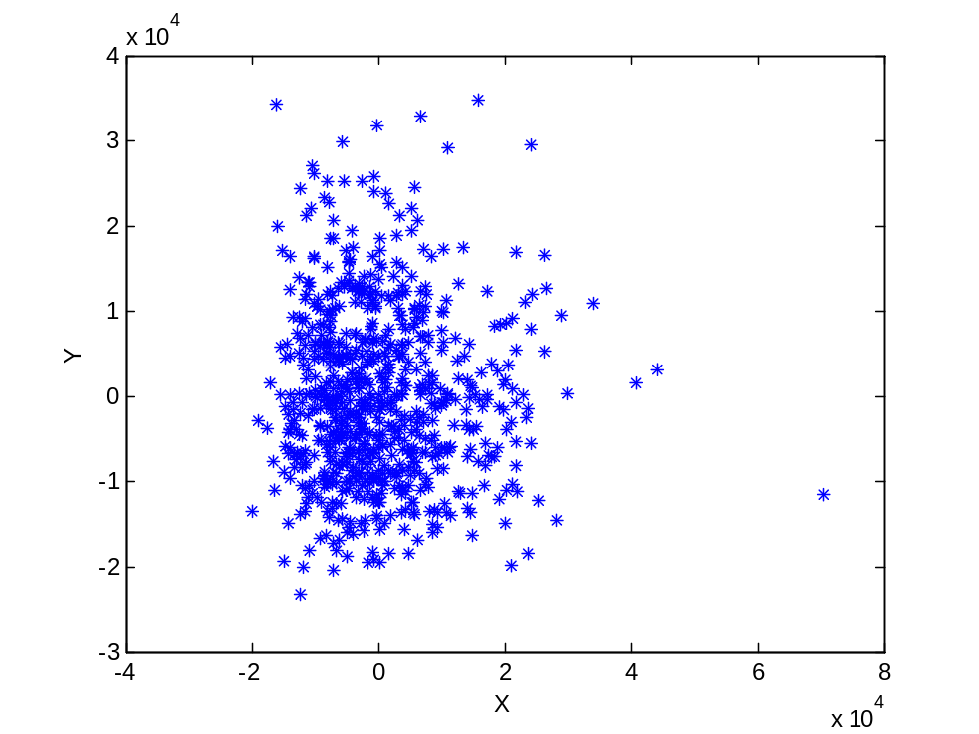
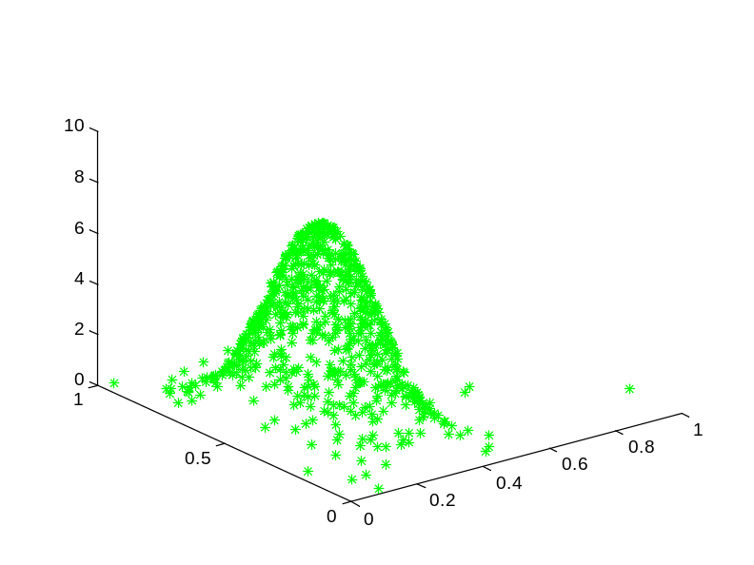
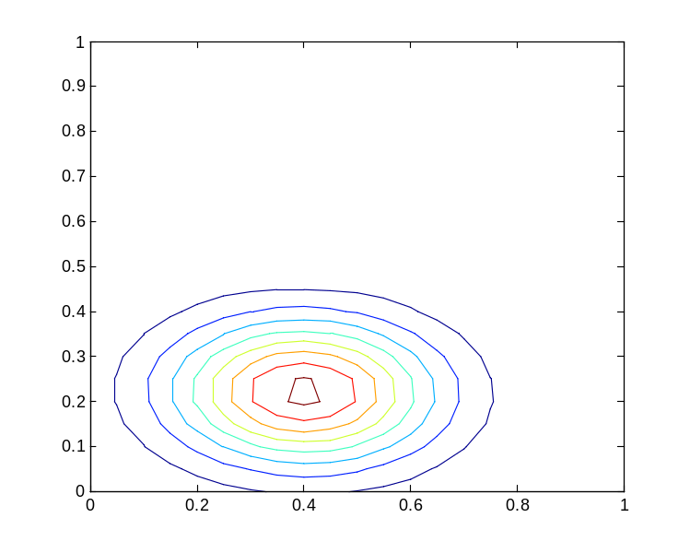
0.0122 -0.0004
-0.0004 0.0297
correlation (x,y) = -0.0229
Comment: (x ⊥ y)

Slide 11
MAP/ML CLASSIFIERS BUILT USING MULTIVARIATE GAUSSIAN DISTRIBUTIONS

Slide 12
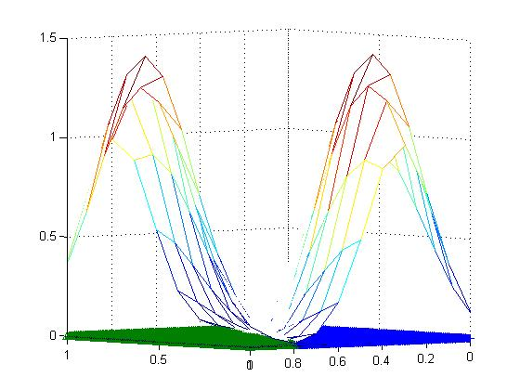
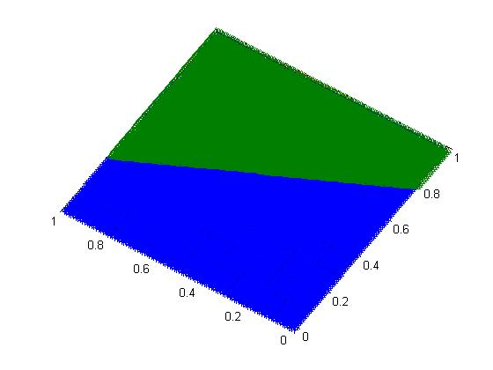
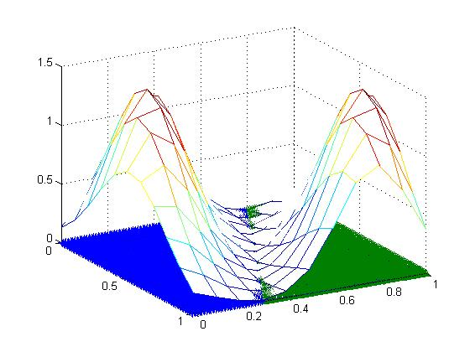
Multivariate Gaussian Distribution Based Classification…same covariance matrices…same priors
sigma1 = [.5^2 -0.10;-0.10 .3^2];
sigma2 = sigma1;
mean1 = [.3 .2]’;
mean2 = [.7 .9]’;
You can also plot them in 2D using plot and in 3D using mesh function of Matlab

Slide 13
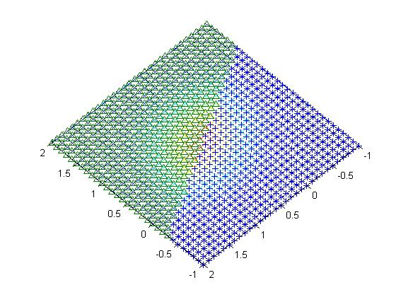
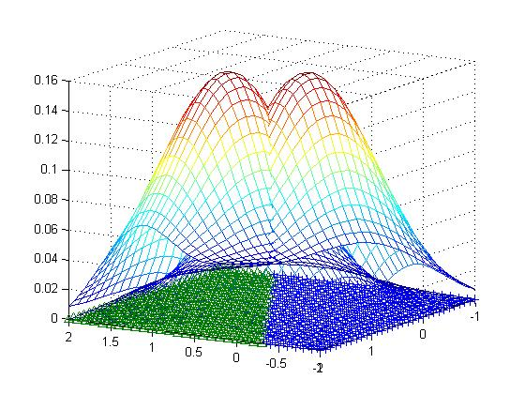
Multivariate Gaussian Distribution Based Classification…same covariance matrices…same priors
sigma1 = [1 0;0 1];
sigma2 = sigma1;
mean1 = [.3 .2]’;
mean2 = [.7 .9]’;
You can also plot them in 2D using plot and in 3D using mesh function of Matlab

Slide 14
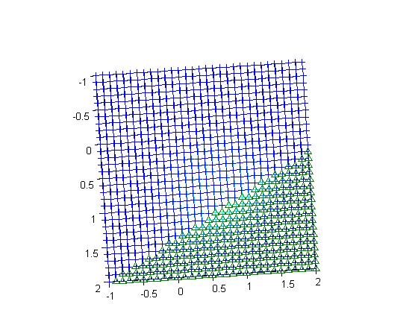
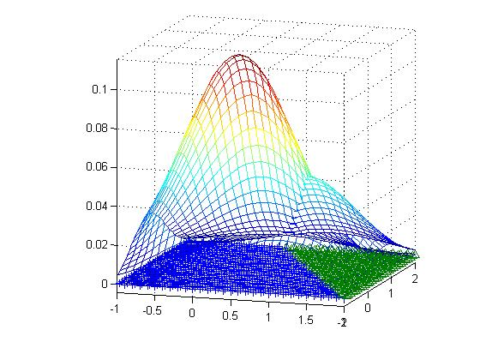
Multivariate Gaussian Distribution Based Classification…same covariance matrices…different priors
sigma1 = [1 0;0 1];
sigma2 = sigma1;
mean1 = [.3 .2]’;
mean2 = [.7 .9]’;
prior1 = 0.7;
prior2 = 0.3;
You can also plot them in 2D using plot and in 3D using mesh function of Matlab

Slide 15
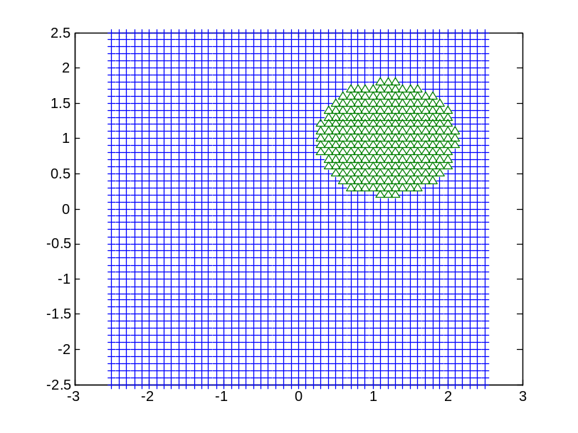
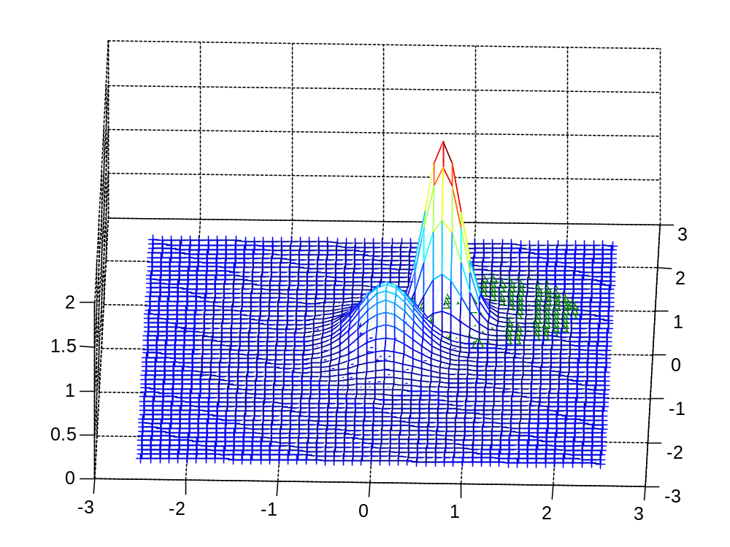
Multivariate Gaussian Distribution Based Classification…diagonal covariance matrices…same priors
sigma1 = [.3^2 0;0 .4^2];
sigma2 = [.2^2 0;0 .2^2];
mean1 = [.1 .2];
mean2 = [.7 .8];
You can also plot them in 2D using plot and in 3D using mesh function of Matlab

Slide 16
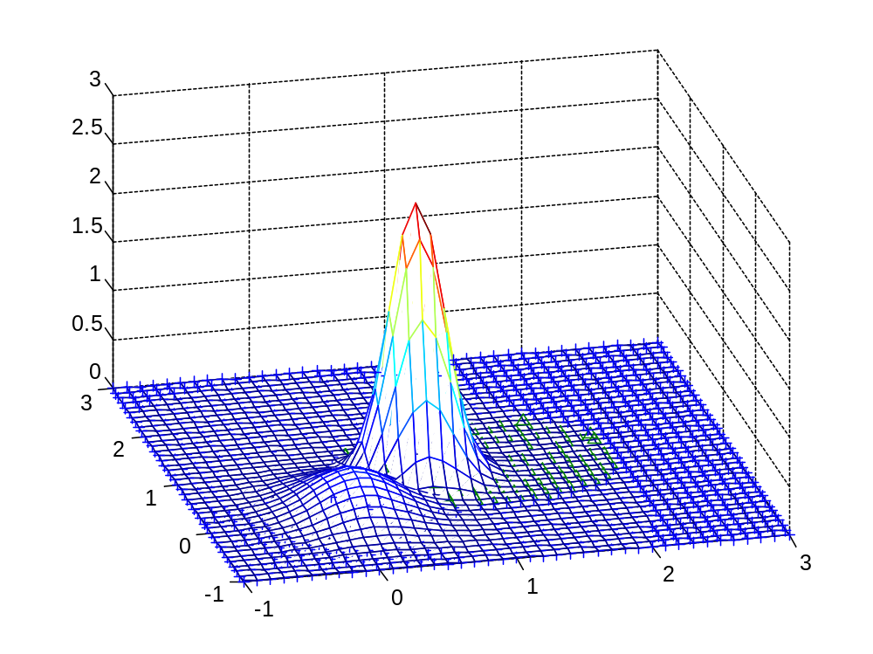
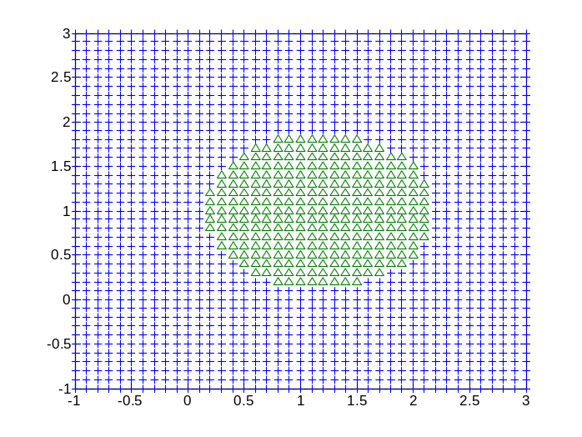
Multivariate Gaussian Distribution Based Classification…diagonal covariance matrices…different priors
sigma1 = [.3^2 0;0 .4^2];
sigma2 = [.2^2 0;0 .2^2];
mean1 = [.1 .2];
mean2 = [.7 .8];
Notice the contours of Gaussians are ellipses
prior1 = 0.3;
prior2 = 0.7;

Slide 17
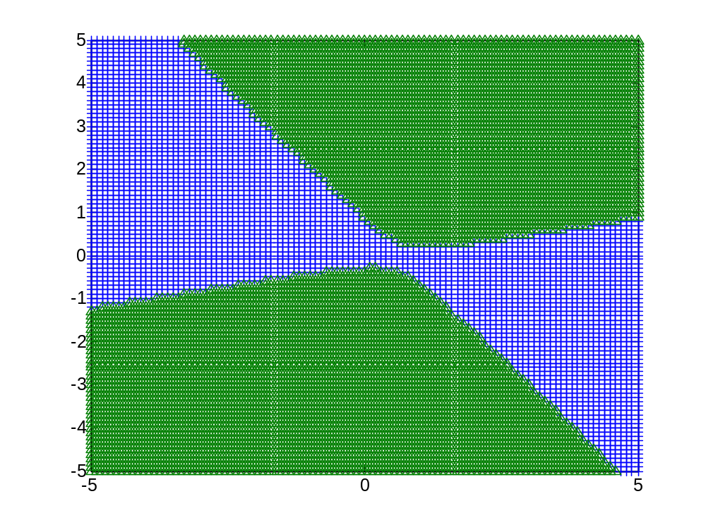
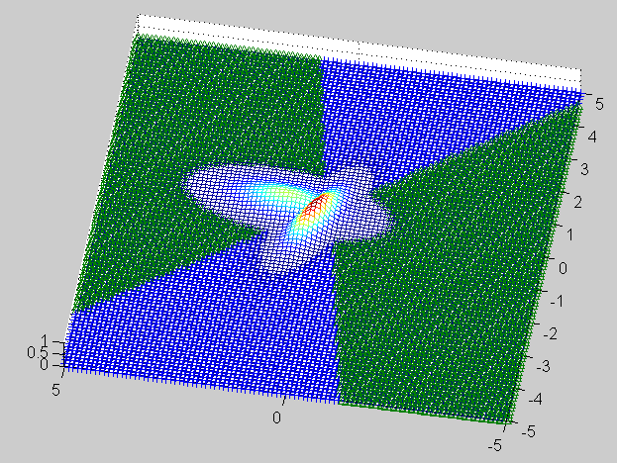
Multivariate Gaussian Distribution Based Classification…different covariance matrices…same priors
sigma1 = [.5^2 -0.10;-0.10 .3^2];
sigma2 = [.3^2 +0.05;0.05 .7^2];
mean1 = [.3 .2];
mean2 = [.7 .9];

Slide 18
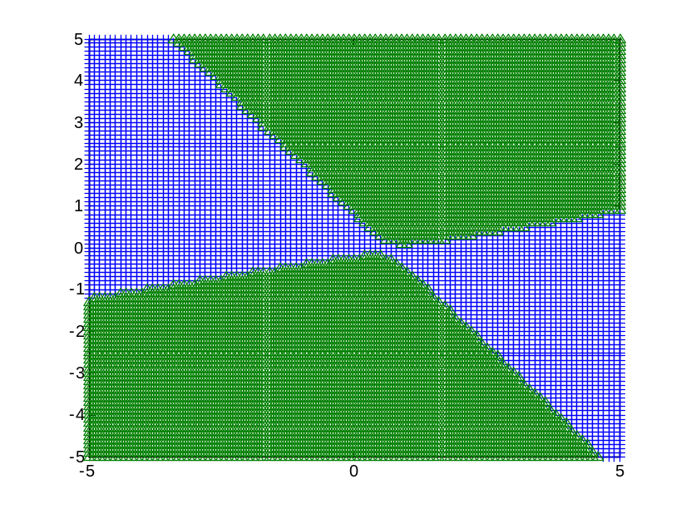
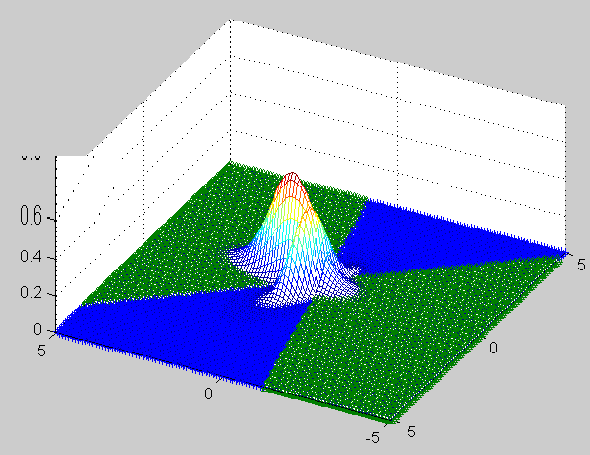
Multivariate Gaussian Distribution Based Classification…different covariance matrices…different priors
sigma1 = [.5^2 -0.10;-0.10 .3^2];
sigma2 = [.3^2 +0.05;0.05 .7^2];
mean1 = [.3 .2]’;
mean2 = [.7 .9]’;
prior1 = 0.3;
prior2 = 0.7;
You can also plot them in 2D using plot and in 3D using mesh function of Matlab

